Slide 1

Skyline
Group #29
Elizabeth Dayton, Daniel Smith, Everett Clemons, William Brown

Slide 2
Team 29 and Scrum Roles
Elizabeth Dayton - Developer/Product Owner - developed transitioning screens, slime enemy, and score/life tracking
Daniel Smith - Developer - scrolling world and level design
Everett Clemons - Developer/Scrum Master - Developed sprints, helped guide general design of Skyline, developed Player, Coins, Life, and Scrolling world code as well as general sounds/music.
William Brown - Developer- projectiles

Slide 3
Overall Project Design
Our overall image for the game and how it changed during the progression of development
35
25
22

Slide 4
Side-Scrolling Platformer
Our vision for this game was a Mario-like platformer that kept scrolling until you reached the end
We incorporated simple left, right, and jumping motion along with projectiles to kill enemies (instead of jumping on top of them)
We also wanted to include engaging sounds and screens, collectibles, a score system, and some way to keep track of the player’s ‘life’
Initially we also wanted to include multiple enemy types and a timer, but found that time limited our enemy types to one and that we had no real need for a timer

Slide 5
How the game evolved over time
Getting the world to scroll turned out to be a much more difficult process than we had originally thought it to be
Even after we got it to scroll the way we wanted, it limited the size of the world, essentially making the level very, very short
In order to fix this without totally scrapping the world scrolling code we instead to decided to create 3 shorter levels with increasing difficulty
This made the game a decent length, enjoyable, and limited the break up of gameplay by ensuring that each new level was unique and not simply a continuation of the previous level

Slide 6
How the game evolved over time cont.
In addition, we also wanted the game to have at least 2 unique enemy types, but because of the time limit of just 4 weeks, we only had time to create 1
We also had to scrap the idea of a transitional screen between levels because of problems we had towards the end of development with tracking score and life

Slide 7
Trello & GroupMe
How we used Trello and GroupMe to stay organized
35
25
22

Slide 8
Trello
We used Trello to manage our goals and sprints.
We blocked things off into three groups
Before Beta, After Beta, and Before Final/Touch Ups
Using this system allowed us to stay organized and keep our goals manageable for the deadlines we had.
After each item was completed, we moved it to the “Done” column.
We also used Trello to upload and store basic images and assets for all developers to use.

Slide 9
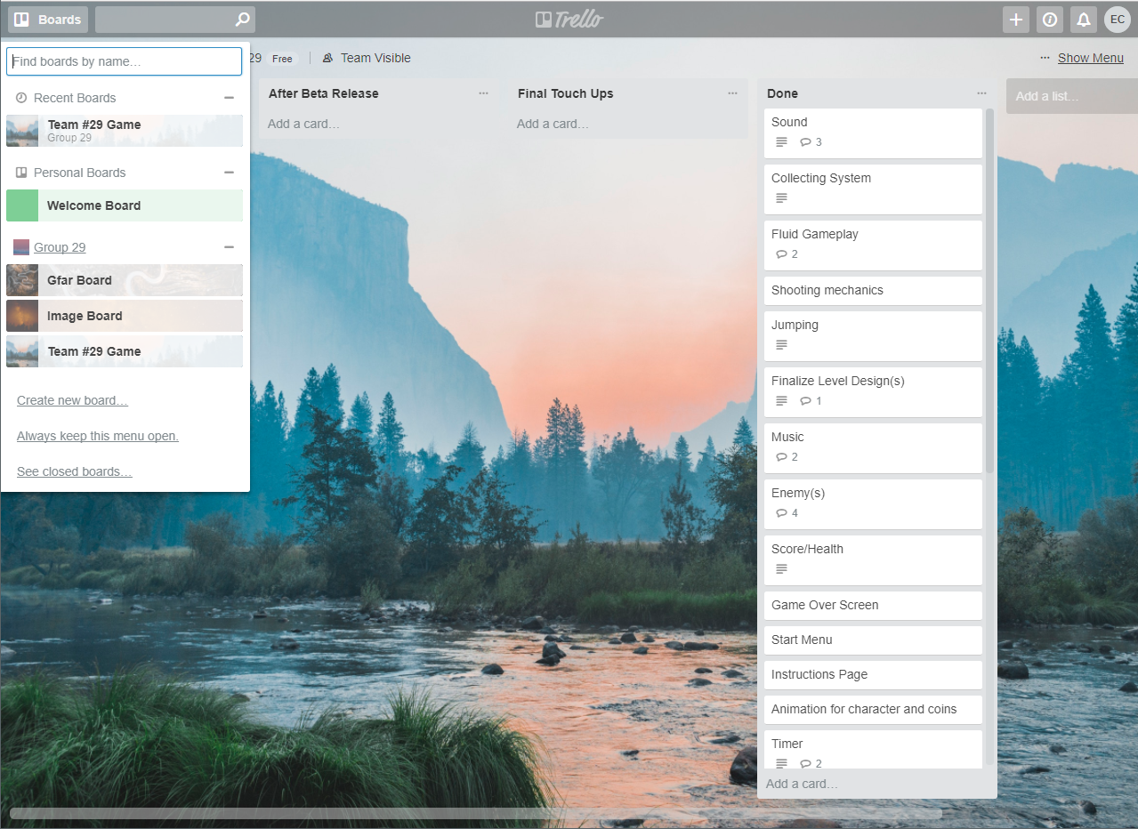
Trello

Slide 10
GroupMe/Canvas
GroupMe was also extremely vital to keeping in touch with group members outside of lab.
Being able to communicate in one area was very useful to stay in line with our goals and development outside of lab.
We also organized our group Canvas page in such a way that the most recent version of the game was easily accessible so we could easily edit it individually and reupload it as needed.

Slide 11
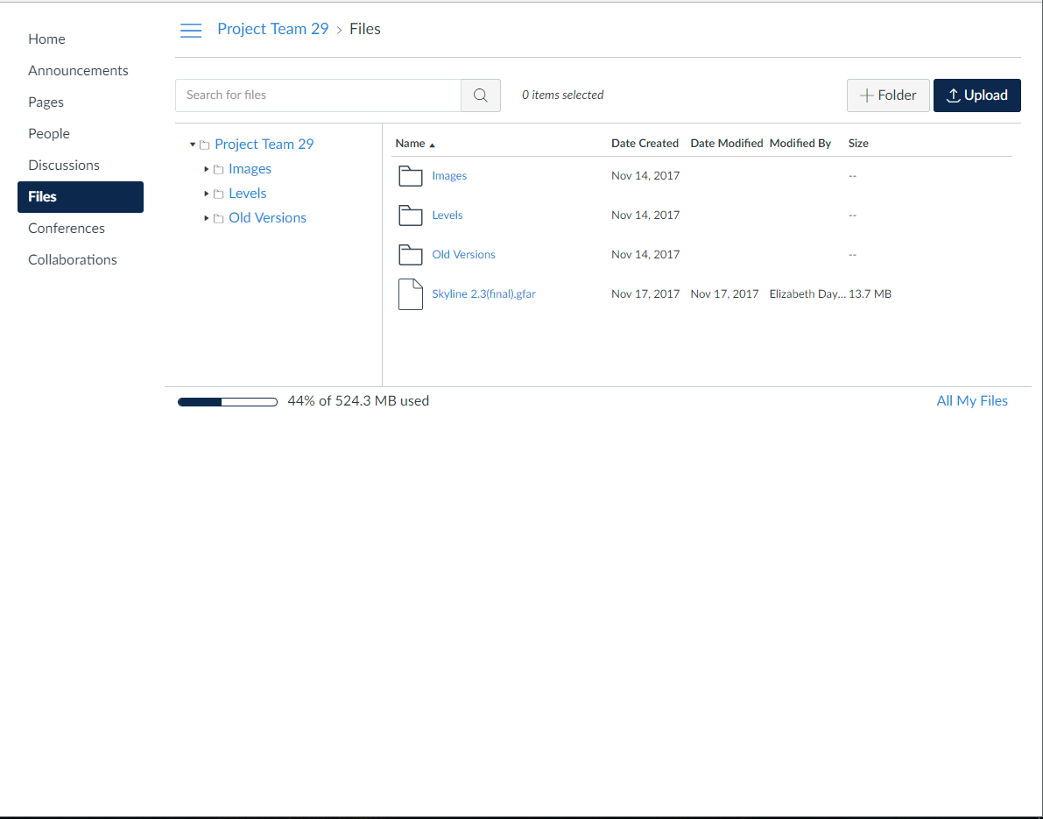
GroupMe/Canvas

Slide 12
Elizabeth Dayton
Developing the Transitional Screens(Start Screen/Instructions/You Win Screen/End Game Screen), slime enemy, and score/life tracking
35
Developer/Product Owner
25
22

Slide 13
Transitional Screens
Used a free online photo-editor on fotor.com to create the text with a transparent background
Then implemented those png files as actors in different worlds in order to display different screens when certain actions took place

Slide 14
Slime Enemy
We wanted the slime enemy to move back and forth on a platform and be removable by a projectile shot by the player
The biggest challenge was getting the slime actor to recognize not only that it was on a platform, but where the edges of that particular platform were
I referenced some online material from danpost at greenfoot.org to get it working just right
I also made it so that the player image blinks to visually notify the player that it has hit an enemy and taken damage (life has been deducted half a heart)

Slide 15
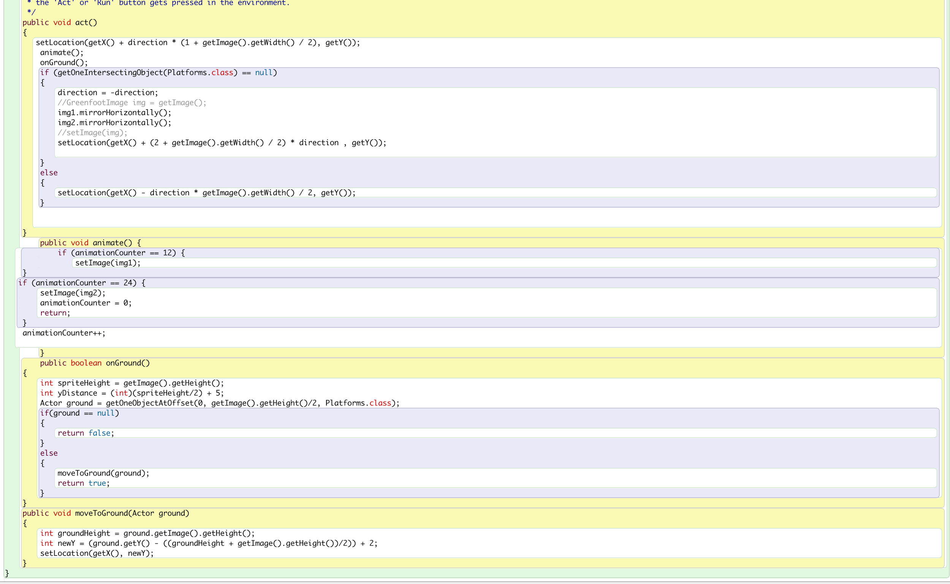

Slide 16
Score and Life Tracking
In the early stages of the game, before we had enemies to really judge this, we were unaware that the game was creating a new player when you transitioned to a new level, essentially resetting the score and life back to zero and full respectively
In order to fix this and have the same player transition into each world, we had to have each world constantly keeping track of the status of the player (i.e. the player’s score and health) so that the next world could then move that player from the previous world into itself

Slide 17
Score and Life Tracking Cont.
We had to move most of the code (apart from the scrolling world and actual level design code) for the game into the player class so that the player could keep track of its own information and share it with the multiple worlds it would be moving through
Even then, there was still a problem with the scrolling world needing a ‘scroll actor’ in order to scroll properly
This required making the player have a method that returned itself so that a world could reference that player but just simply saying Player.getPlayer()

Slide 18
Daniel Smith Developer
Scrolling World and Level Design
35
25
22

Slide 19
Scrolling World
Used material posted by Kevin Rowan’s and Jim Stewart’s online tutorials to help develop a scrolling world for Skyline.
Everett also modified the scrolling world using material from danpost on greenfoot.org.
Working together to combine our code allowed us to create the fixed sized scrolling world for Skyline that includes multiple levels.

Slide 20
Level Design
Using research done on greenfoot.org allow us to create a system of level design that doesn't require the manual input of every object and actor’s xy coordinates.
By assigning an object or actor to a particular character we could visually design the levels from within the code.

Slide 21
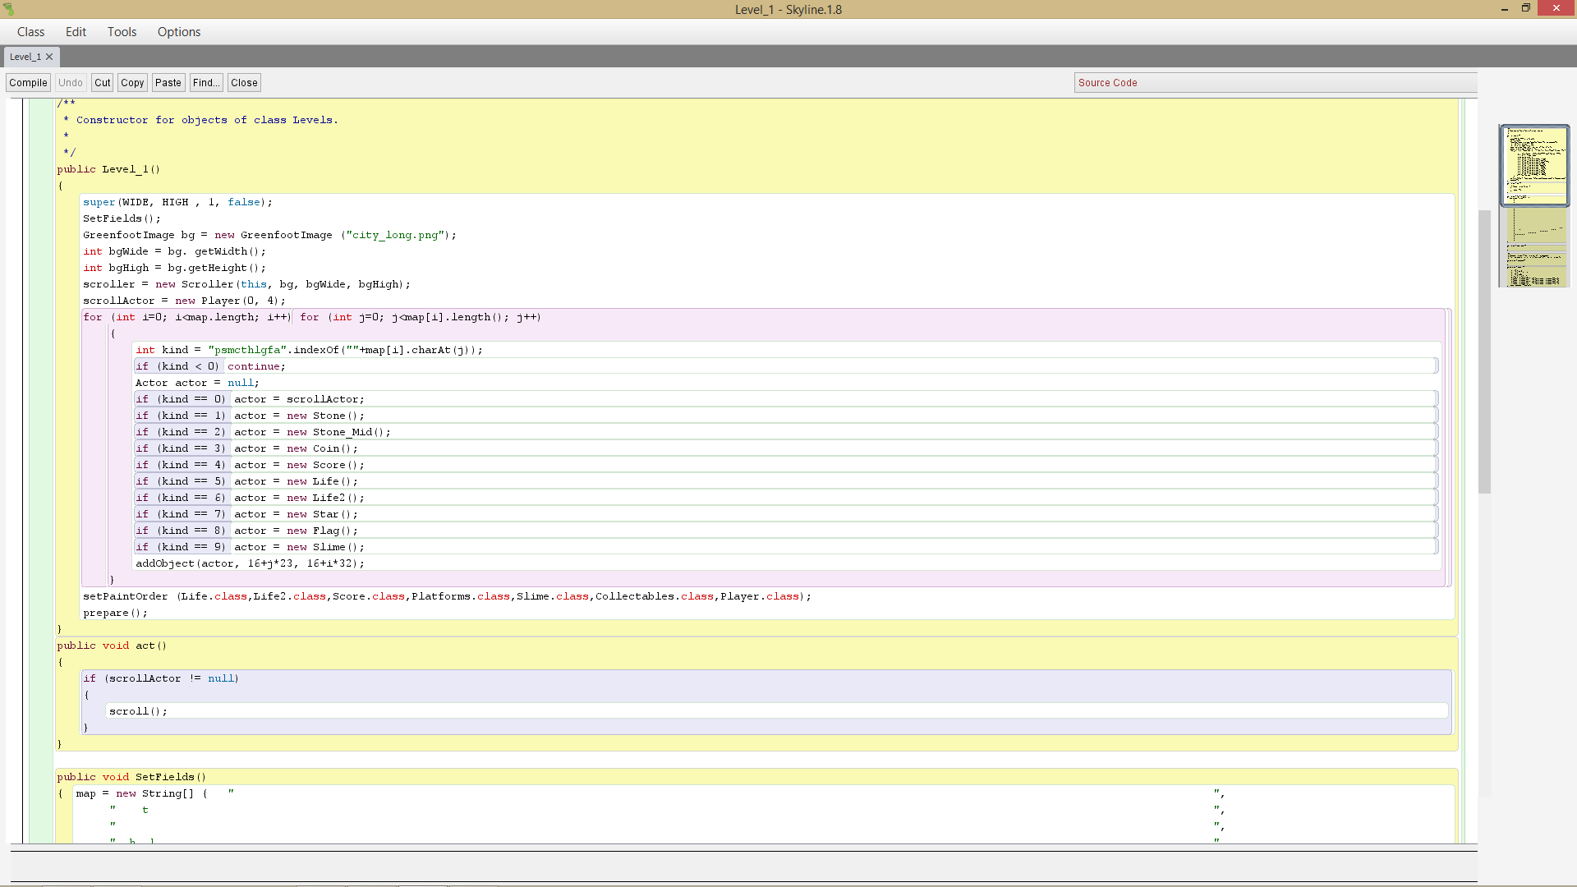

Slide 22
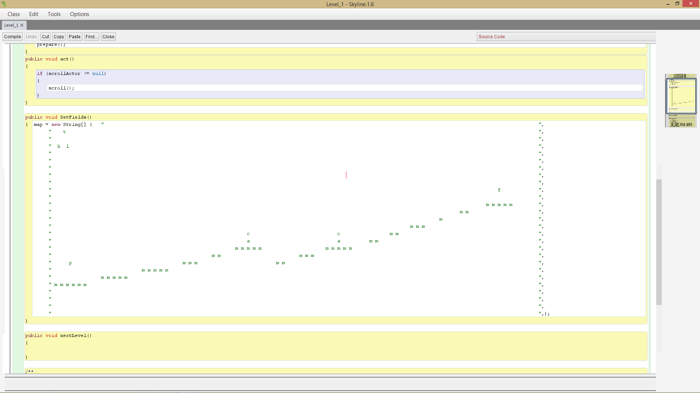

Slide 23
Everett’s Intro Slide
Developing the Player, Life System, Coins,Scrolling Class, and Sound
35
Developer/Scrum Master
25
22

Slide 24
Player, Coins, & Life System
We looked for online help a lot to develop the player and scrolling world. We needed the player to be able to move left and right freely and most importantly, jump and come back down to where the player jumped.
I had to adapt the code to our liking and fitting, while keeping the overall functionality intact. I had to change the movement controls, jump speed, and jump power to get the gameplay that we felt was ideal.
Also found a free sprite set online with no trademark license and implemented a simple animation counter that we used in all classes with animation.
Being able to use our online resources in ways that we could adapt to our project was vastly important.

Slide 25
Player, Coins, & Life System cont.
The player is also able to collect coins/stars and collide with flags to proceed to the next level.
We used the simple getOneIntersectingObject methods for these collisions.
I was also able to use the heart images found in our sprite pack to create a health system that kept track of how many hits the player took and restarted the game when the player died.
In the Player class, I just used an int to keep track of the health and subtracted one for every hit the player took. When health == 0, the game restarts.
In the Life class, I created another int that each of the two life classes took from a method in the Player class that just returned the Player’s life.
Using int life = getWorld().getObjects(Player.class).get(0).Life(), I was able to make two Life objects that were full hearts when life == 4 or 2, half hearts when life == 3 or 1, and removed themselves when life == 2 or 0;

Slide 26
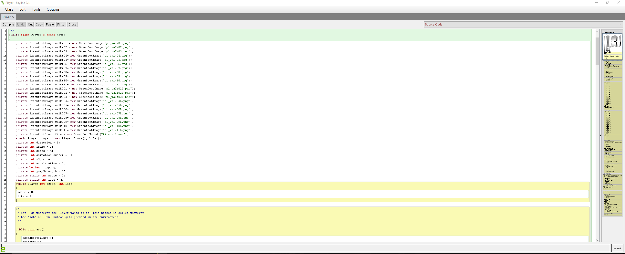
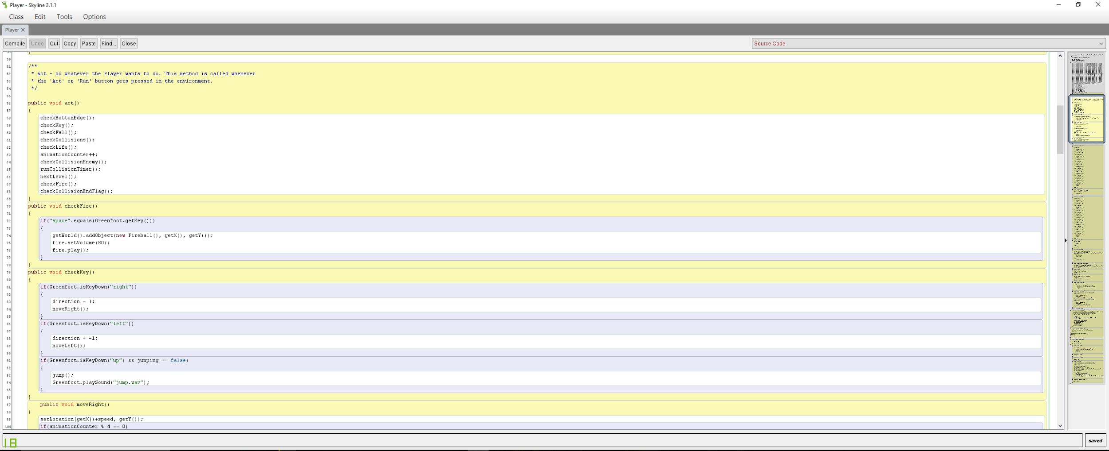
Player & Coins

Slide 27
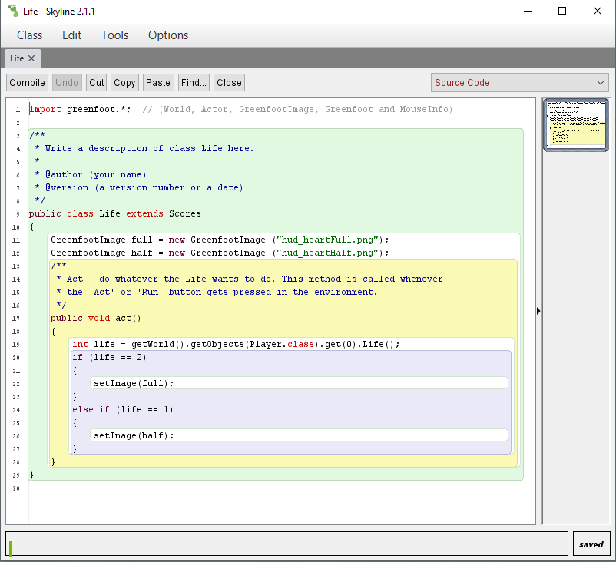
Life System

Slide 28
Scrolling World
Implementing a working, scrolling world into our game was one of the most vital part of our overall image for the game.
I also had to use online resources to find code to adapt to our liking.
I had to change the viewport size, the speed the scroller class actually moves the objects in the world the opposite direction of the player, and when it would start scrolling.
Credit to @DanPost from greenfoot.com for the code we adapted for both the Player movement and the Scroller class.

Slide 29
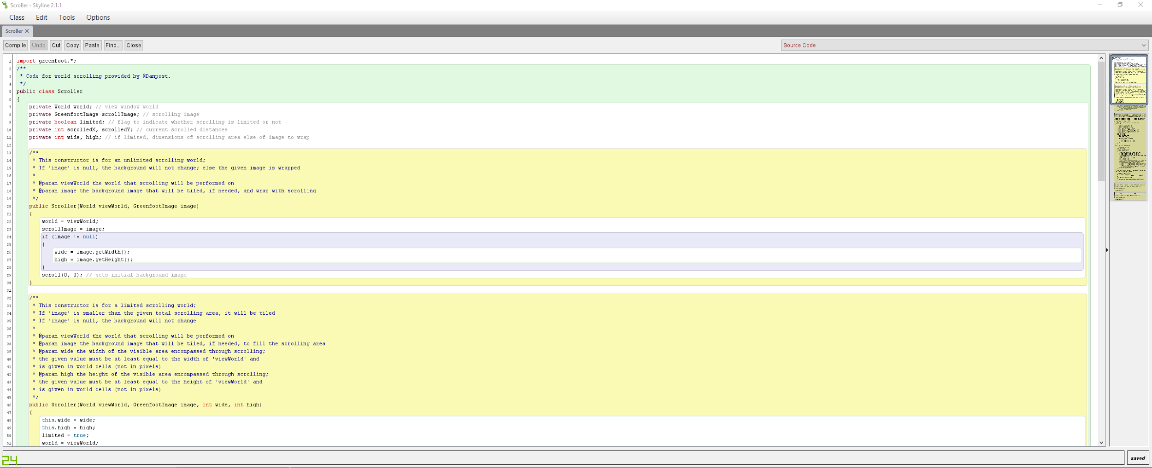
Scrolling World

Slide 30
Sounds/Music
I found all sound files from freesound.org
I luckily found a lot of good 8-bit/Mario sounding files that fit in perfectly with the overall theme of the game.
I also wrote the background music in FL Studios.

Slide 31
William’s Intro Slide
Projectiles
35
Developer
25
22

Slide 32
Projectiles
Researched projectiles on greenfoot.org
Implemented projectiles for use by the player
Removes the slime actor from the world on contact
Used a free sprite for the fireball projectile

Slide 33
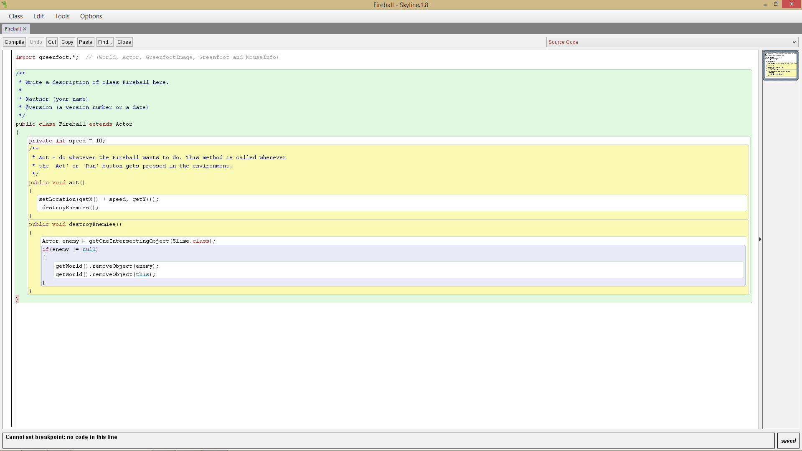

Slide 34
Conclusion
Communication and Teamwork were key
35
25
22

Slide 35
Lessons Learned
Through this project, we all learned how important both teamwork and communication are
The in-class meetings were not enough for us to really get to the heart of what we wanted to accomplish through this project
We all had to spend time outside of class working on our respective parts to make Skyline what it is
And we can all say we’re proud of what we managed to create in just 4 short weeks

